Slide 1

01
1
SMART CELL IMAGE
02
AGENDA
SMART CELL PROJECT
2
TIEN SON TIME STUDY SYSTEM
3
03
NEXT ACTION
04
4
REFERENCE
Notes:
Behalf for innovation team I would like to… progrens of smart cell
4 reference about another factory

Slide 2


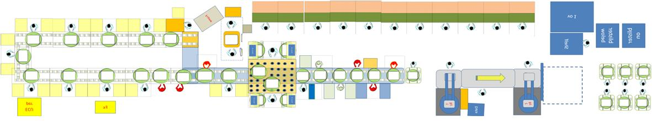
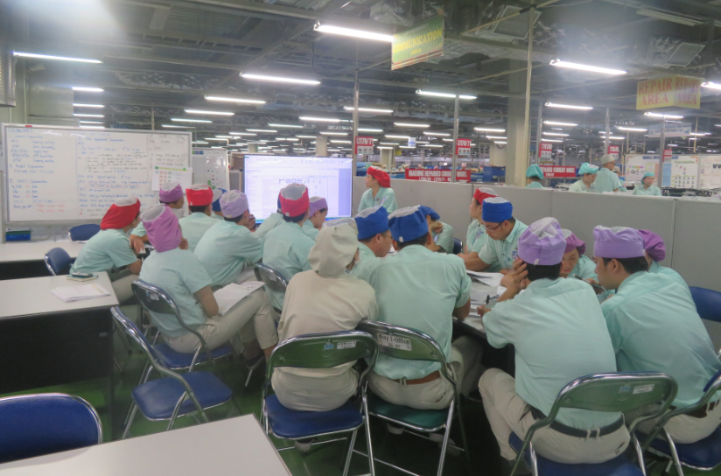
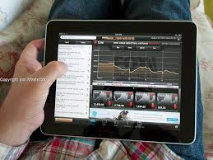

FINAL SMART CELL IMAGE
Focus
PM check sheet
ESD check
Grease amount Alert
Checker system
Changing point control
(Destination- Part )
Time Study –Audit]
⑧
②-③
Quality index
TSS system
ECO system
⑦
⑨
Driver Force check
⑥
EOS – Label – LED check
QAFC- X-R Bar Alert
Packing Evident
④
⑤
①
Prevent Skip / Forgot Operation [ RFID – Camera ]
Navigation System for new op
“Lot – No.” system
NG
Action
Auto warning
Auto analysis
Complete Auto Data Trend Management Program
Notes:
the parts in blue are the parts we already have
white is the system we will design in the near future
To day I want to focus to .. Alrealdy running in tien fac

Slide 3
REAL TIME-TIME STUDY SYSTEM
PURPOSE, We focus:
Real time control: we want to know Normal/Abnormal real time rhythmical or not
=>Abnormal detect -> Quick action
Loss Analysis: Muda/muri/mura
=>Kaizen performance up/Shojin
40s
30s
70s
50s
50s
50s
Notes:
you know each cell each model has a certain cycle time for workers to complete the process,
if we can detect any problem station or mc we can improve it to optimize the quality as well as worker capacity,
and this system to do it

Slide 4




SMART CELL SCHEDULE
Smart cell
04
Future
Prevent skip operation (auto warning when OP skip or miss part)
Navigation System for new op
Image recognition technology
03
Next plan
Order RFID and mainboard for 26 Station of line TM15-2
Setup and apply for all station TM15-2
02
Current (We are here)
Make Graphic
Make real time study system
Program version 1.0
Running on 3 station Line TM15-2
01
Before
New Cell Launching Some Station not catch up Speech
Over comparison with Cycle time
Abnormal Operation
Skip operation
Q1
Q2
Q3
Q4
Q1
Q2
Q3
Q1
Q3
Q4
2020
Jul.2021
Nov.2021
2022
Notes:
Here

Slide 5
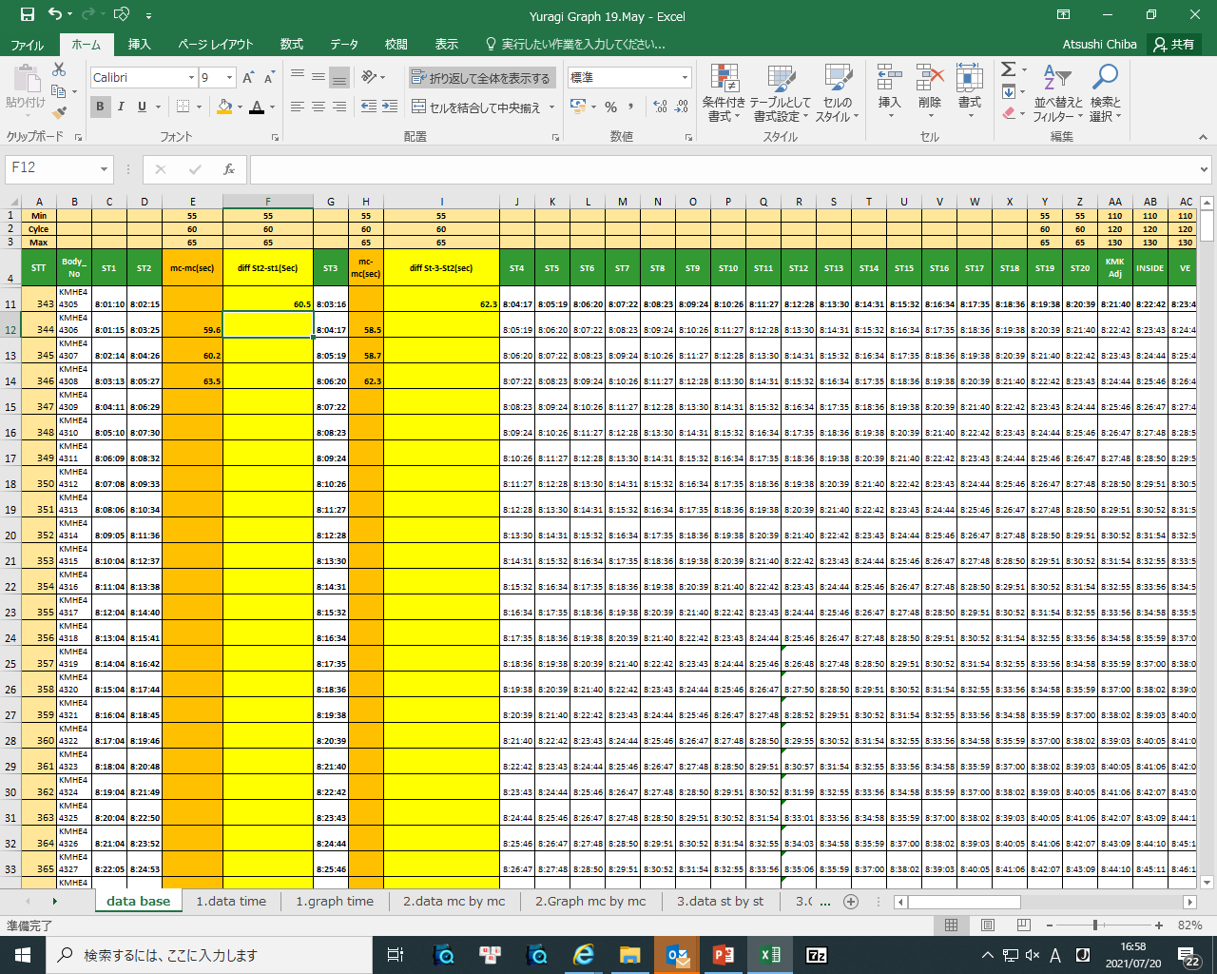
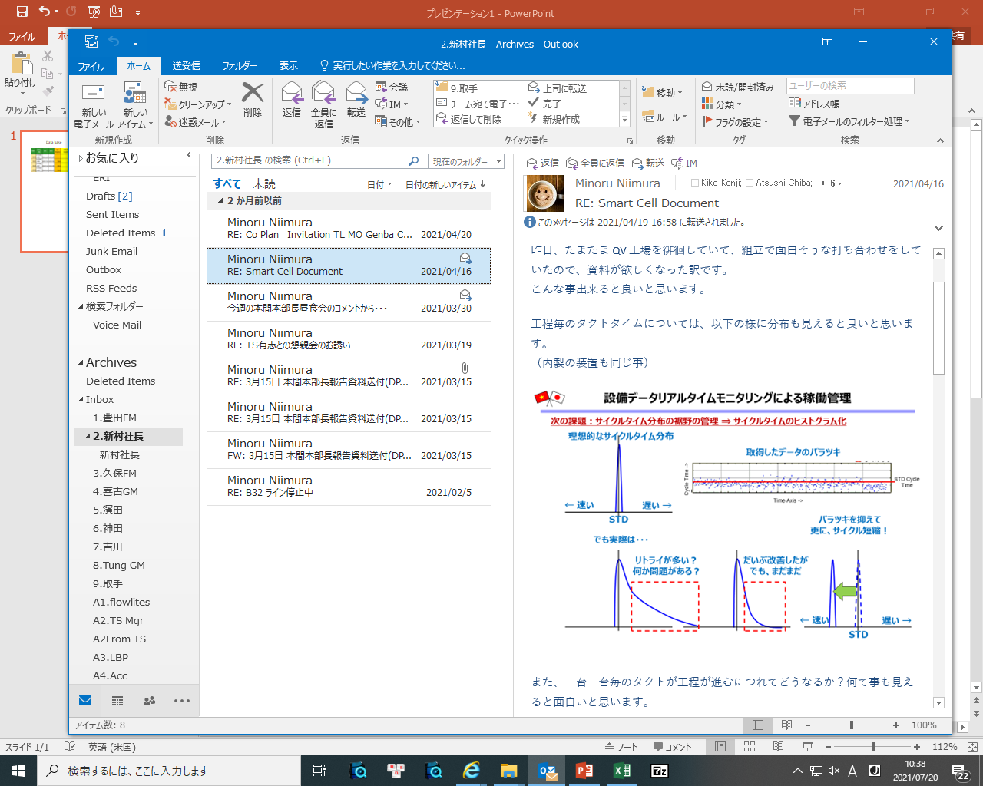
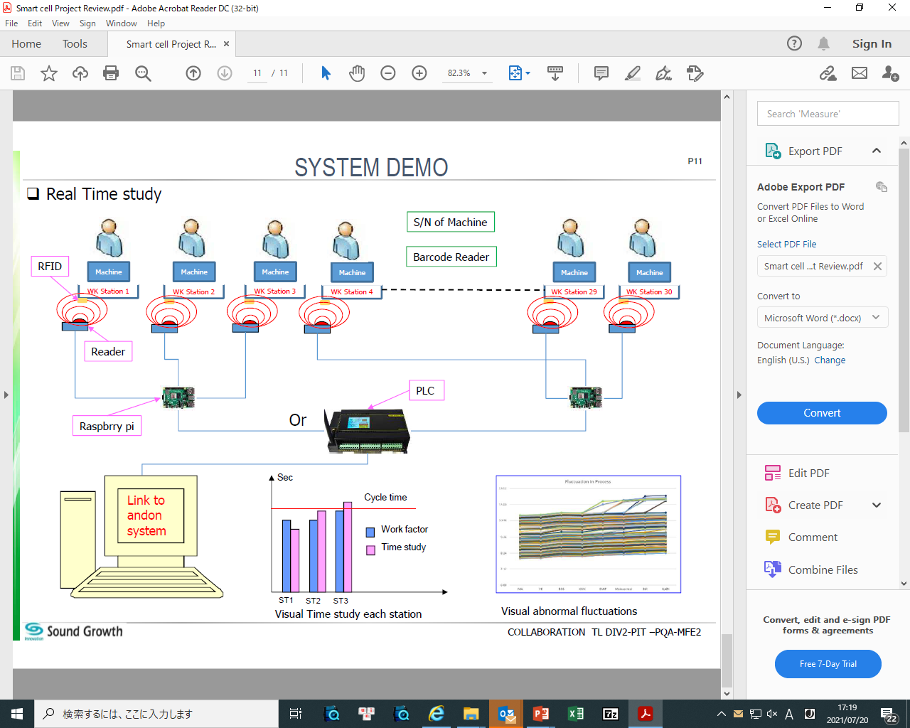
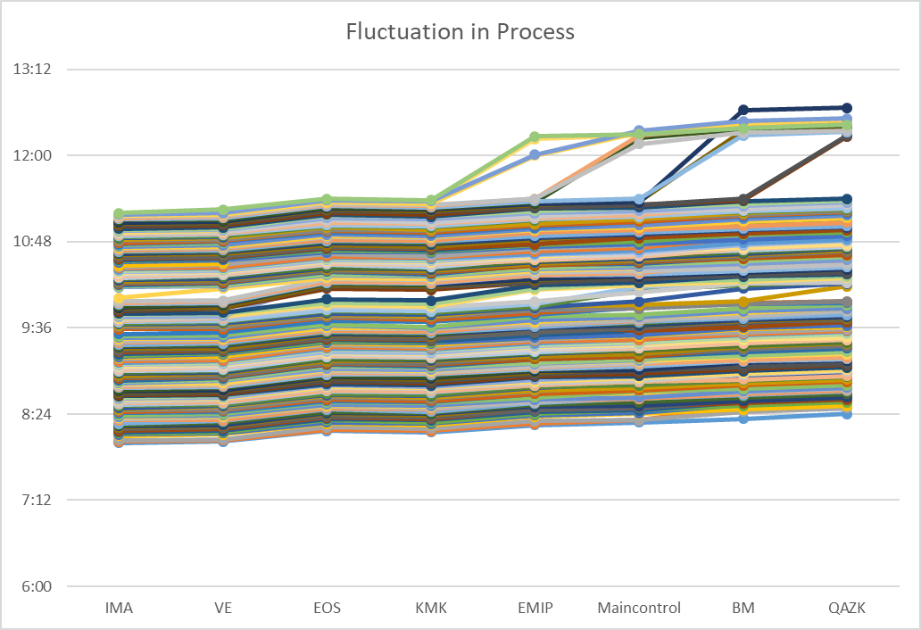
Graphic(next step)
Database
PF of ST by ST
(muda muri mura)
ST by ST /Production progress Real time
Normal time study
What ST is bottle neck from what machine
=> alert if over spec continue 5mc..
ST1
ST2
ST1
ST2

Slide 6


STRUCTURE OF SYSTEM
Reading ID
No1
Card ID2
Reading ID
No2
Card ID 1
Table
Station 1
Station 2
Reading ID
Card ID
Notes:
the system uses the table and rfid reader to measure the cycle between stations,
we originally planned to read the bodyno of the machine but you know each bodyno model will stick in a different position..
When the table slides over the rfid reader,
the system will read the signal and push it to the server
the time between the first machine minus the time to finish the next machine

Slide 7

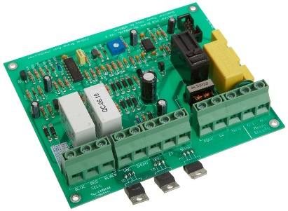

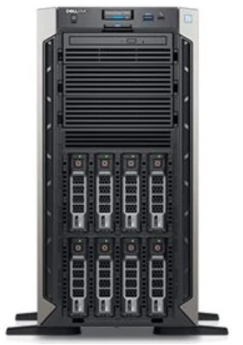
STATION 1
STATION 2
STATION 3
STATION 4
PC1
PC3
PC2
SERVER
PC4
Notes:
system overview
Together
Your computer.

Slide 8
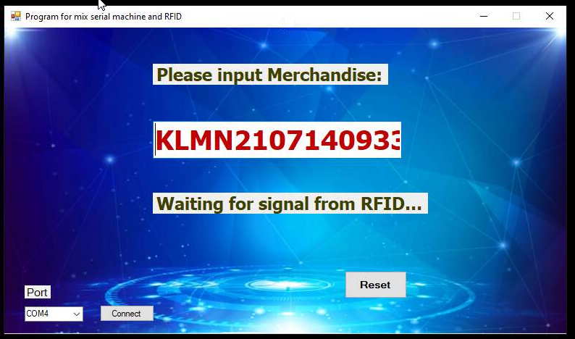
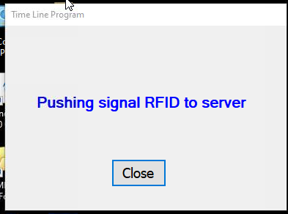
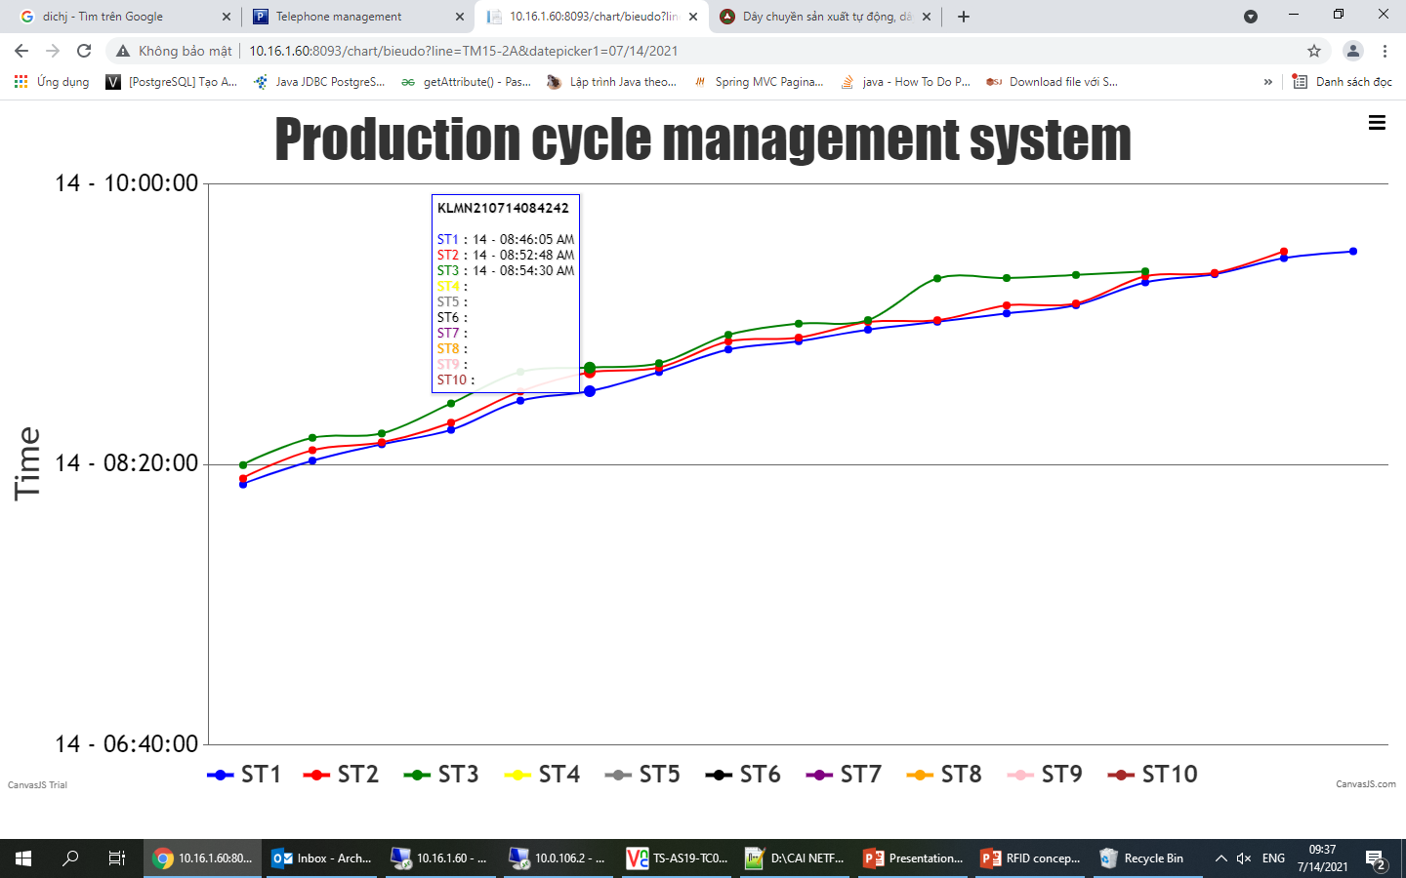
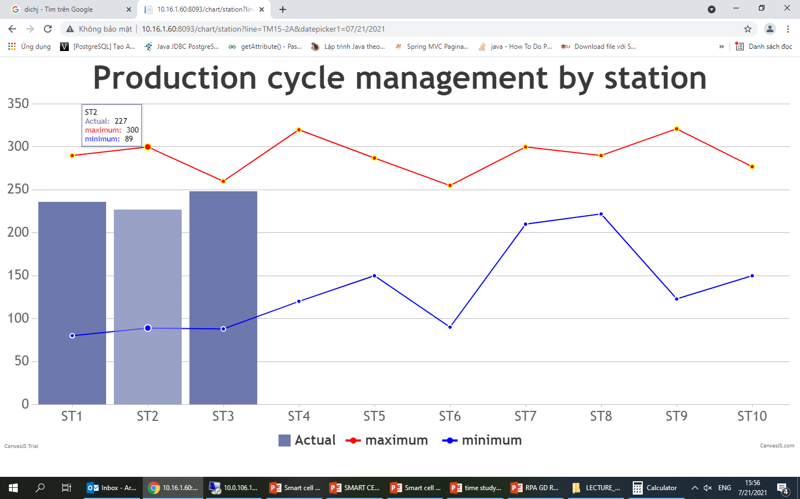
SOFTWARE
This system combine Merchandise of machine and card number RFID at ST1, finally push up data to server
System that listens for signals from RFID (ST2->ST…) reader and handing data, finally push up data to server
Notes:
Introduce about software design and using
In the end we get 2 graphs like under

Slide 9
Next Action
No | Job items | Aug |  |  |  | Sep |  |  |  | Oct
 |  | 6 | 13 | 20 | 31 | 7 | 13 | 20 | 30 | 8 | 15 | 22 | 29
1 | Make Graphic tendency |  |  | ▼
2 | Make function alert when over spec continue 5mc.. |  |  |  |  | ▼
3 | Order RFID and mainboard for all station TM15-2 |  |  |  |  | ▼
4 | Setup RFID for all station TM15-2 |  |  |  |  |  |  | ▼
5 | Expand for Model D67 |  |  |  |  |  |  |  |  |  | ▼
Expand
METHOD: the system must run real time and correctly and stable
RFID: when using RFID USB cannot convert to digital signal for processing
Cost: the cost for 1 production line must be low
When repairing the machine, must carry the table with the machine (OP need check out machine)
Problem
Notes:
The next part is the plan in the near future
You know, when doing any project, we also get the difficulties

Slide 10
Reference
Que Vo Time Study system
 | SETUP | REAL TIME ALL STATION | COST /CELL | ALL STATION | ADD FUCTION | EXPAND
TIEN SON | EASY | YES | 1500$ | YES |  | EASY
QUE VO | EASY | NO |  | YES | SKIP OPERATION | Difficulty in image recognition
Notes:
Que Vo also has same system but uses a different method than ours,
and here are some comparisons of the 2 factory

Slide 11
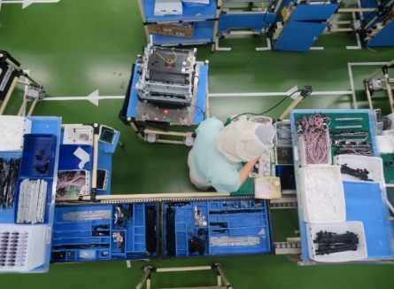
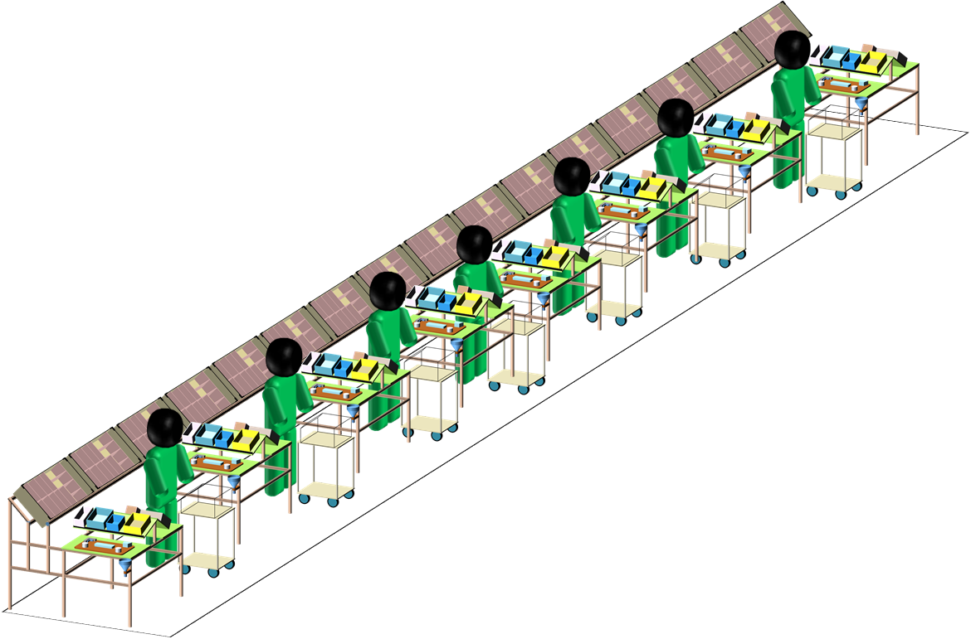
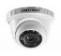
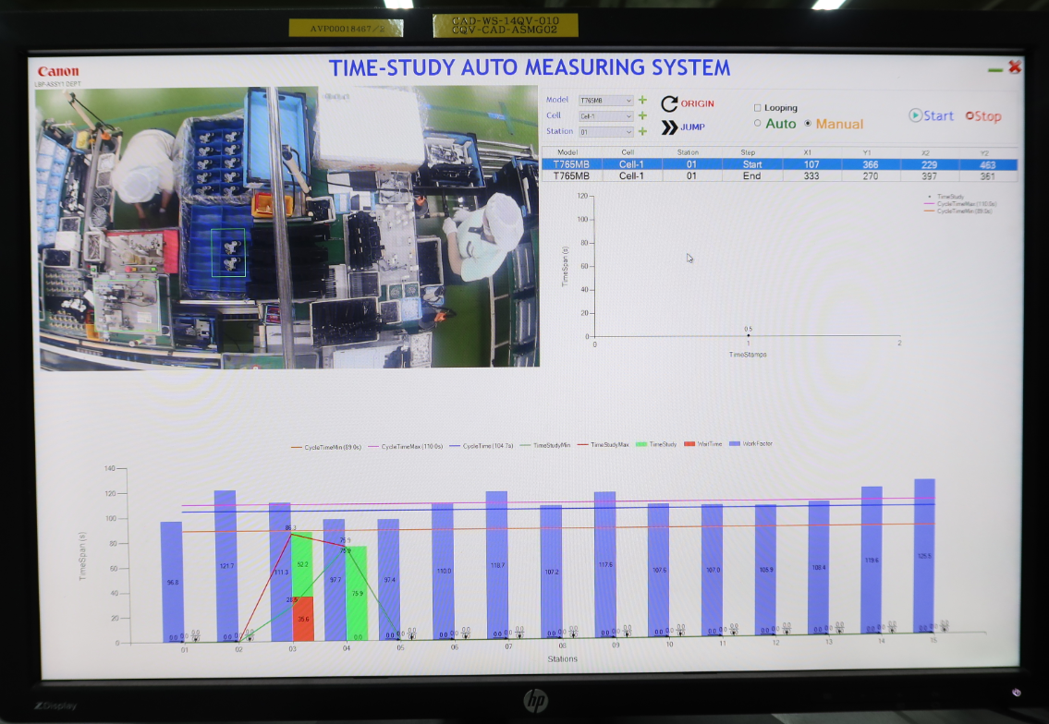
START
QUE VO CONCEPT
Moving system camera
END
Use the camera to measure 5 times for 1 Station and then take the average time, then move on to another Station

Slide 12
PREVENT SKIP OPERATION
(Purpose)
Alert when Operator Skip or forgot Operation .
(Target )
To achieve Line balance > 95 %
Camera
Utilize for
Detect skip => Alert
Normal
Abnormal
Critical problem [Function]
Oil – Ink
New comer
Skip Operation
Kitting tray
Operation ❶
Operation ❶
Operation ❷
Operation ❹
❺
=> Alert
Working area
A
Operation ❸
Operation ❸
Effective
❶
Operation ❹
Operation ❷
No Rework / Recheck .
Operation ❺
Operation ❺
marking
Check sheet less system connect
Can not shipping
if skip operation
All Cell/All ST
Apply Motion sensor /automatic tracking function
Notes:
this is the big idea that all 3 factories are looking for
If a OP forgets a part of the machine or does it incorrectly, it big consequen on the quality
Bell alert

